Slide 1



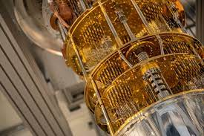
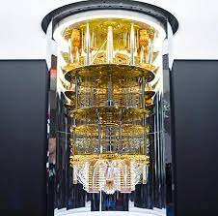
Quantum processors and computing
IW2

Slide 2

Let’s dive in
A classical computer use 1’s and 0’s to demonstrate the operation, in contrast quatun computer use quantum bits or qubits. And they can be both 1 or 0 at the same timewhich is called superposition, and it’s happening inside our body in MRI machine we can observe that. N qubits means $2^{n};Qubit−behaves like an artificial atom$
The second property of quantum is that entanglement – the states of entagled qubits cannot be described independently each other. (hard to separate them)
A lot of technologies-computers,laser, nuclear power plants; exists because of our understanding of quantum physics.
It is(quantum physics) hard to imagine but we can demonstrate well with the help of math.

Slide 3
Quantum processors
Researchers in Toronto used a photonic quantum computer chip to solve a sampling problem that went way beyond the fastest computers and algorithms.
The paper the researchers published says that the Borealis quantum chip took only 36 microseconds to solve a problem that would take supercomputers and algorithms 9,000 years to figure out.
The authors of the study said,
“This work is a critical milestone on the path to a practical quantum computer, validating key technological features of photonics as a platform for this goal.”

Slide 4
Quantum computing
First of all we should understand that quantum computers are not next generation computer, it is another technology; just look at candle and light bulb, they are two different things.
And it has a huge potential to impact our future; including security-create private key for encrypting messages; healthcare- for drug development; even Internet-teleportation of information without physically transmitting.

Slide 5
What makes me excited about Quantum?
There is so many things which we can do with our classical computers and we always talk about their abiliites that they can do but we never talk about what they cannot do, at this point quantum computers come into play and solve so big problems.
For now, anyone without a quantum computer isn’t missing out on anything. Quantum computers can’t yet function any better than our classic computers can and aren’t expected to do so for at least another decade
Applications of it quite board and we need find them. – what we need to do
It is sure that we will not get quantum computer in our house near soon.(but it is possible with clouds) And I don’t think they will replace the regular ones but what they will do is quite hard and impressive.
When I think about it, it is like there is no problem you cannot solve with quantum computers and it makes me think some crazy sci-fi things.

Slide 6
Some deep notes:
There are some problems which we cannot do with our regular computers.
It calculates things but totally in a differeny way than classical computer.
And we undoubtly think that with this computers we can do a lot of great things, including understanding nature better.

Slide 7
References and more:
https://www.youtube.com/watch?v=QuR969uMICM
https://www.youtube.com/watch?v=ARWBdfWpDyc
https://www.youtube.com/watch?v=OWJCfOvochA

